Slide 1
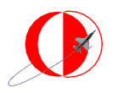
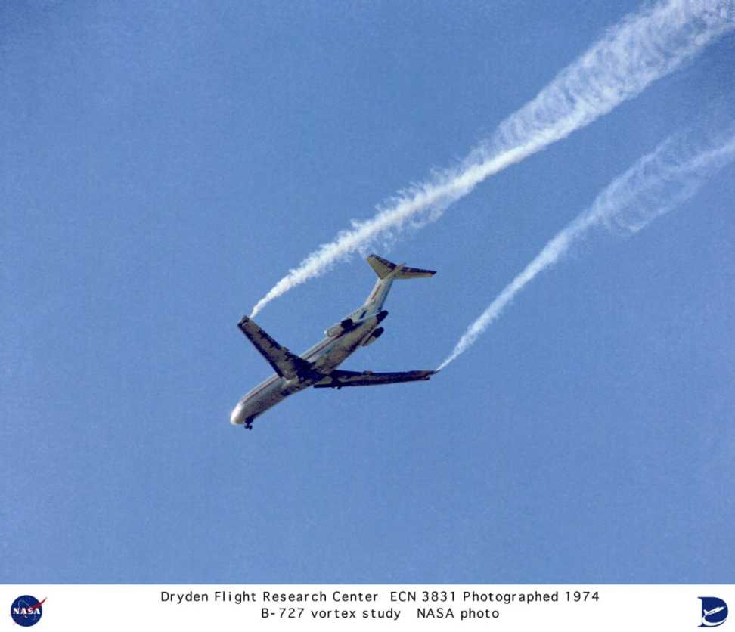
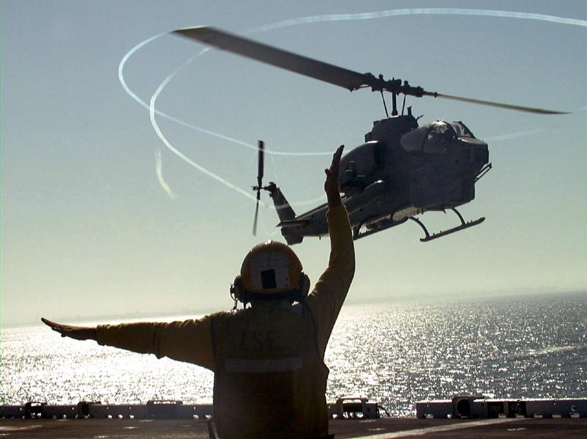
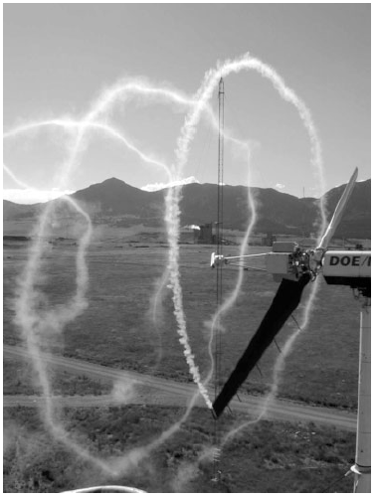
Middle East Technical University
Department of Aerospace Engineering
AE 495 Wind Energy and Wind Turbine Technology
2011-2012 Fall Semester
PROJECT TITLE
OBJECTIVE
The objective of this project is to …
You can put your own project related pictures here and a short description of your project.
Project Group Members
Student 1
Student 2
…
You can fill in these boxes with project related text, figures and pictures
You can fill in these boxes with project related text, figures and pictures
You can fill in these boxes with project related text, figures and pictures
You can fill in these boxes with project related text, figures and pictures

